Slide 1
EMTH403
Mathematical Foundation for Computer Science

Slide 2
Lecture Outcomes
understand what are duals of Boolean expression.
understand what is a Complemented Lattice.
understand what is Boolean Algebra.

Slide 3
Duality
To explain the relationship between the two identities in each pair we use the concept of a dual.
The dual of a Boolean expression is obtained by interchanging Boolean sums and Boolean products and interchanging 0s and 1s.

Slide 4
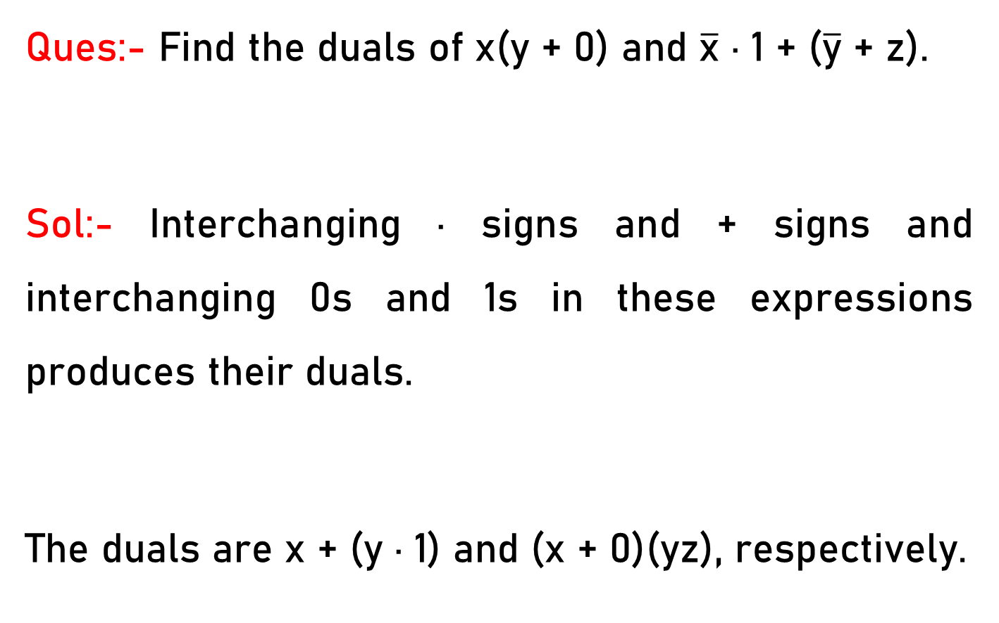
Duality
Ques:- Find the duals of x(y + 0) and $\overline{\text{x}}$ · 1 + ($\overline{\text{y}}$ + z).
Sol:- Interchanging · signs and + signs and interchanging 0s and 1s in these expressions produces their duals.
The duals are x + (y · 1) and (x + 0)(yz), respectively.

Slide 5
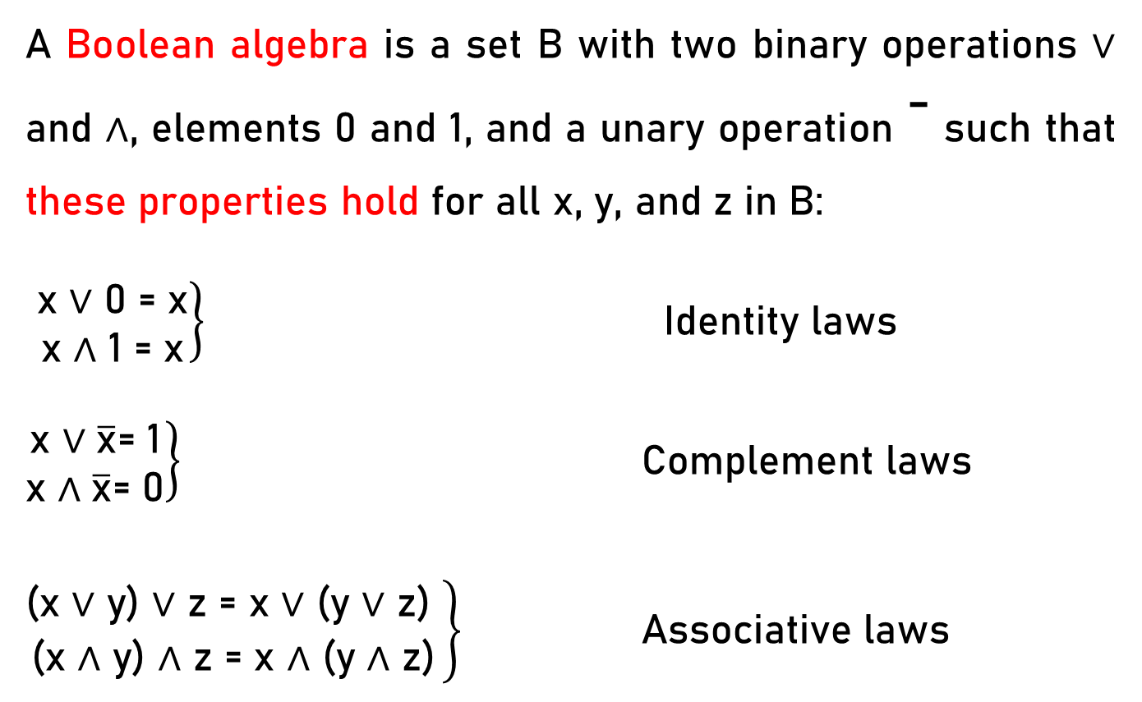
Boolean algebra
A Boolean algebra is a set B with two binary operations ∨ and ∧, elements 0 and 1, and a unary operation ⁻ such that these properties hold for all x, y, and z in B:
$\left.\begin{matrix}\text{x}\text{ ∨ 0 = }\text{x} \\ \text{x}\text{ ∧ 1 = }\text{x}\end{matrix}\right\}$ Identity laws
$\left.\begin{matrix}\text{x} \text{∨} \overline{\text{x}}\text{= 1} \\ \text{x} \text{∧} \overline{\text{x}}\text{= 0}\end{matrix}\right\}$ Complement laws
$\left.\begin{matrix}\text{(}\text{x}\text{ ∨ }\text{y}\text{) ∨ }\text{z}\text{ = }\text{x}\text{ ∨ (}\text{y}\text{ ∨ }\text{z}\text{) } \\ \text{(}\text{x}\text{ ∧ }\text{y}\text{) ∧ }\text{z}\text{ = }\text{x}\text{ ∧ (}\text{y}\text{ ∧ }\text{z}\text{)}\end{matrix}\right\}$ Associative laws

Slide 6
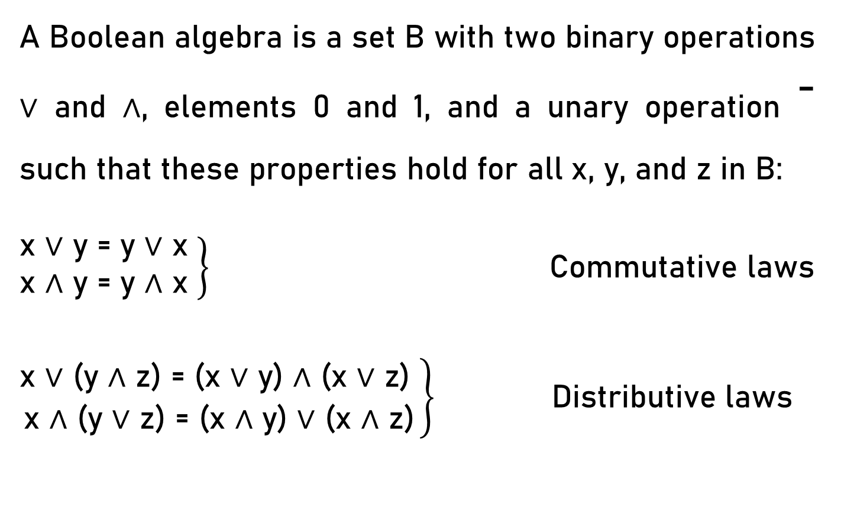
Boolean algebra
A Boolean algebra is a set B with two binary operations ∨ and ∧, elements 0 and 1, and a unary operation ⁻ such that these properties hold for all x, y, and z in B:
$\left.\begin{matrix}\text{x}\text{ ∨ }\text{y}\text{ = }\text{y}\text{ ∨ }\text{x} \\ \text{x}\text{ ∧ }\text{y}\text{ = }\text{y}\text{ ∧ }\text{x} \end{matrix}\right\}$ Commutative laws
$\left.\begin{matrix}\text{x}\text{ ∨ (}\text{y}\text{ ∧ }\text{z}\text{) = (}\text{x}\text{ ∨ }\text{y}\text{) ∧ (}\text{x}\text{ ∨ }\text{z}\text{) } \\ \text{x}\text{ ∧ (}\text{y}\text{ ∨ }\text{z}\text{) = (}\text{x}\text{ ∧ }\text{y}\text{) ∨ (}\text{x}\text{ ∧ }\text{z}\text{)}\end{matrix}\right\}$ Distributive laws

Slide 7
Boolean algebra
Boolean algebras may also be defined using the notion of a lattice, discussed earlier.
Lattice L is a partially ordered set in which every pair of elements x, y has a least upper bound, denoted by lub(x, y) and a greatest lower bound denoted by glb(x, y).

Slide 8
Boolean algebra
Given two elements x and y of L, we can define two operations ∨ and ∧ on pairs of elements of L by
x ∨ y = lub(x, y) and x ∧ y = glb(x, y).

Slide 9
Boolean algebra
For a lattice L to be a Boolean algebra, it must have two properties.
First, it must be complemented.
For a lattice to be complemented it must have a least element 0 and a greatest element 1
and for every element x of the lattice there must exist an element x such that x ∨ x = 1 and x ∧ x = 0.

Slide 10
Boolean algebra
For a lattice L to be a Boolean algebra, it must have two properties.
First, it must be complemented.
Second, it must be distributive.
This means that for every x, y, and z in L, x ∨ (y ∧ z) = (x ∨ y) ∧ (x ∨ z) and x ∧ (y ∨ z) = (x ∧ y) ∨ (x ∧ z).

Slide 11
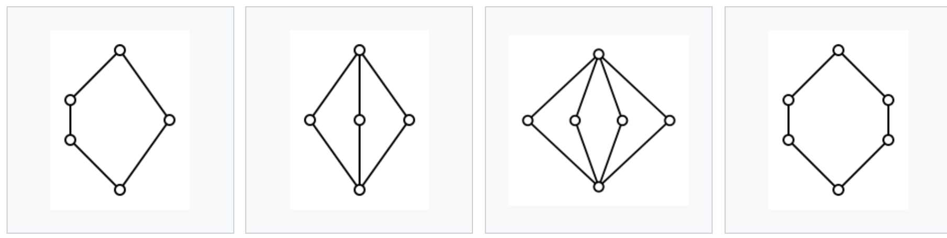
Complemented Lattice
A complemented lattice is a bounded lattice (with least element 0 and greatest element 1), in which every element a has a complement, i.e. an element b satisfying a ∨ b = 1 and a ∧ b = 0. Complements need not be unique.
1
1
1
1
a
b
a
b₁
a
b₁
b₂
a
b₁
b₂
b₃
b₂
0
0
0
0

Slide 12
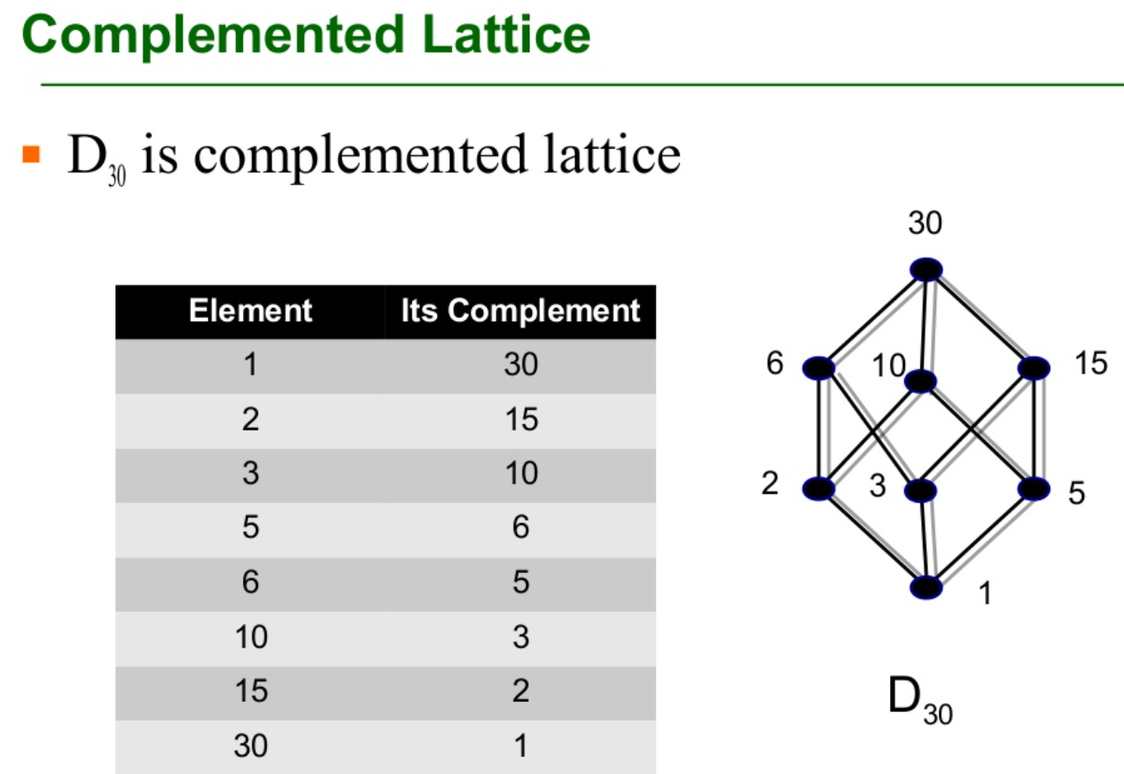
Complemented Lattice
D₃₀ is a complemented lattice.
Element | Its Complement
1 | 30
2 | 15
3 | 10
5 | 6
6 | 5
10 | 3
15 | 2
30 | 1

Slide 13
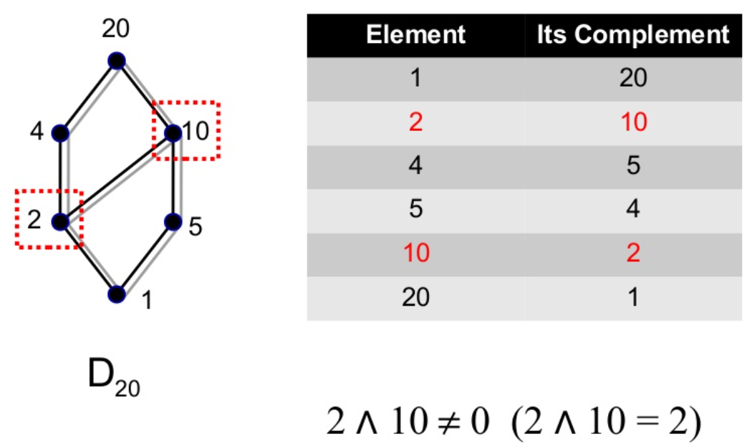
Complemented Lattice
D₂₀ is not complemented lattice.
Element | Its Complement
1 | 20
2 | 10
4 | 5
5 | 4
10 | 2
20 | 1

Slide 14
Boolean algebra
For a lattice L to be a Boolean algebra, it must have two properties.
First, it must be complemented.
Second, it must be distributive.
This means that for every x, y, and z in L, x ∨ (y ∧ z) = (x ∨ y) ∧ (x ∨ z) and x ∧ (y ∨ z) = (x ∧ y) ∨ (x ∧ z).

Slide 15
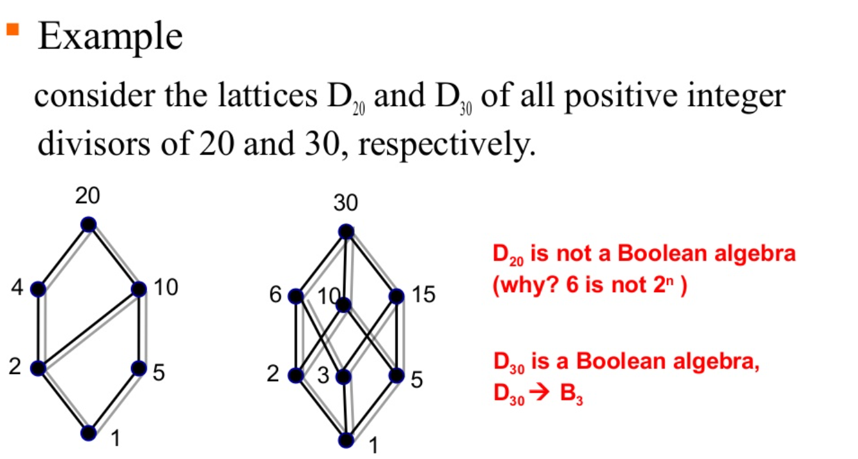
Boolean algebra
Consider the lattices D₂₀ of all positive integer divisors of 20.
D₂₀ is not a boolean algebra.

Slide 16
Boolean algebra
Consider the lattices D₃₀ of all positive integer divisors of 30.
D₃₀ is a Boolean algebra.

Slide 17
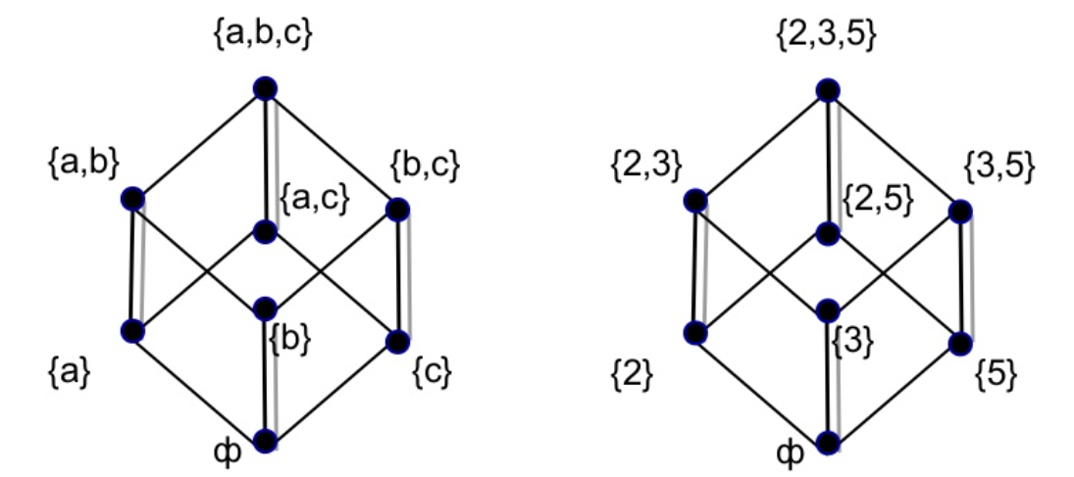
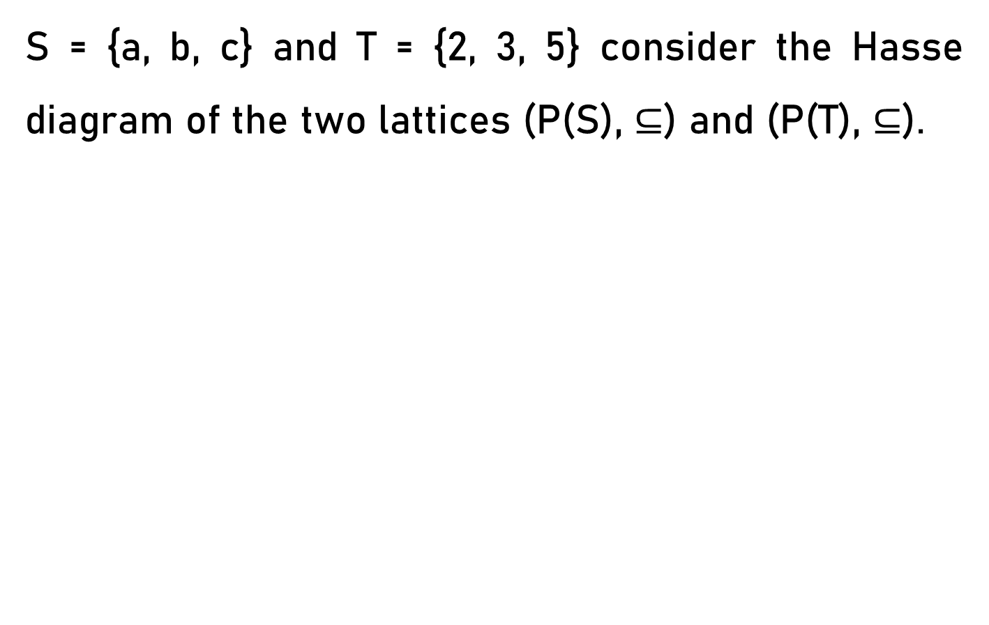
Boolean algebra
S = {a, b, c} and T = {2, 3, 5} consider the Hasse diagram of the two lattices (P(S), $⊆$) and (P(T), $⊆$).

Slide 18
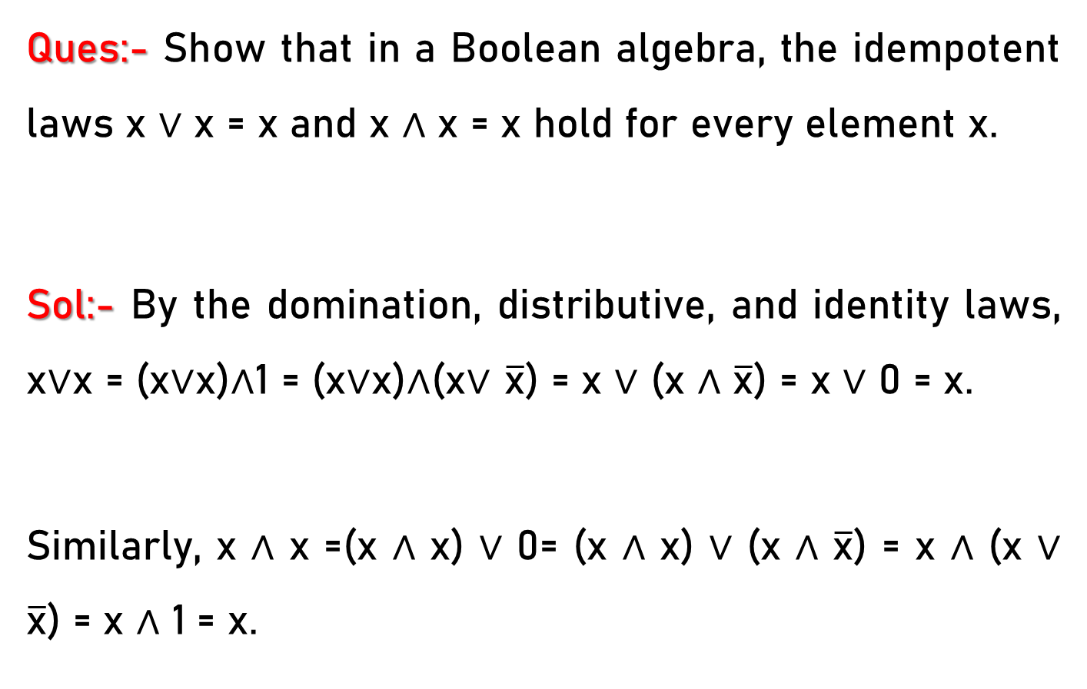
Boolean algebra
Ques:- Show that in a Boolean algebra, the idempotent laws x ∨ x = x and x ∧ x = x hold for every element x.
Sol:- By the domination, distributive, and identity laws, x∨x = (x∨x)∧1 = (x∨x)∧(x∨ $\overline{\text{x}}$) = x ∨ (x ∧ $\overline{\text{x}}$) = x ∨ 0 = x.
Similarly, x ∧ x =(x ∧ x) ∨ 0= (x ∧ x) ∨ (x ∧ $\overline{\text{x}}$) = x ∧ (x ∨ $\overline{\text{x}}$) = x ∧ 1 = x.

